Slide 1
Memory Hierarchy

Slide 2
Memory Hierarchy
This Memory Hierarchy Design is divided into 2 main types:
External Memory or Secondary Memory – Comprising of Magnetic Disk, Optical Disk, Magnetic Tape i.e. peripheral storage devices which are accessible by the processor via I/O Module.
Internal Memory or Primary Memory – Comprising of Main Memory, Cache Memory & CPU registers. This is directly accessible by the processor.

Slide 3
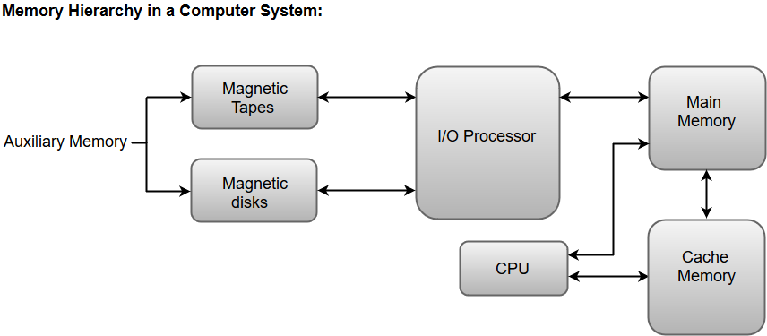

Slide 4
Memory Hierarchy
The Computer memory hierarchy looks like a pyramid structure which is used to describe the differences among memory types. It separates the computer storage based on hierarchy.
Level 0: CPU registers
Level 1: Cache memory
Level 2: Main memory or primary memory
Level 3: Magnetic disks or secondary memory
Level 4: Optical disks or magnetic types or tertiary Memory

Slide 5
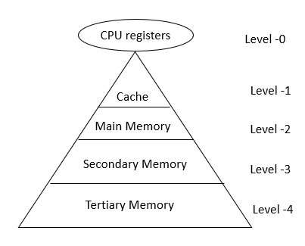
Memory Hierarchy

Slide 6
Memory Hierarchy
In Memory Hierarchy the cost of memory, capacity is inversely proportional to speed. Here the devices are arranged in a manner Fast to slow, that is form register to Tertiary memory.
Level-0 − Registers
The registers are present inside the CPU. As they are present inside the CPU, they have least access time. Registers are most expensive and smallest in size generally in kilobytes. They are implemented by using Flip-Flops.

Slide 7
Memory Hierarchy
Level-1 − Cache
Cache memory is used to store the segments of a program that are frequently accessed by the processor. It is expensive and smaller in size generally in Megabytes and is implemented by using static RAM.
Level-2 − Primary or Main Memory
It directly communicates with the CPU and with auxiliary memory devices through an I/O processor. Main memory is less expensive than cache memory and larger in size generally in Gigabytes. This memory is implemented by using dynamic RAM.

Slide 8
Memory Hierarchy
Level-3 − Secondary storage
Secondary storage devices like Magnetic Disk are present at level 3. They are used as backup storage. They are cheaper than main memory and larger in size generally in a few TB.
Level-4 − Tertiary storage
Tertiary storage devices like magnetic tape are present at level 4. They are used to store removable files and are the cheapest and largest in size (1-20 TB).

Slide 9
Characteristics of Memory Hierarchy
Capacity: It is the global volume of information the memory can store. As we move from top to bottom in the Hierarchy, the capacity increases.
Access Time: It is the time interval between the read/write request and the availability of the data. As we move from top to bottom in the Hierarchy, the access time increases.

Slide 10
Characteristics of Memory Hierarchy
Performance: Earlier when the computer system was designed without Memory Hierarchy design, the speed gap increases between the CPU registers and Main Memory due to large difference in access time.
Cost per bit: As we move from bottom to top in the Hierarchy, the cost per bit increases i.e. Internal Memory is costlier than External Memory.

Slide 11
Memory Hierarchy
Level | Register | Cache | Primary memory | Secondary memory
Bandwidth | 4k to 32k MB/sec | 800 to 5k MB/sec | 400 to 2k MB/sec | 4 to 32 MB/sec
Size | KB | MB | GB | Greater than GB (TB)
Access time | 2 to 5nsec | 3 to 10 nsec | 80 to 400 nsec | 5ms
Managed by | Compiler | Hardware | Operating system | OS or user

Slide 12
Main Memory

Slide 13
Main Memory
The main memory acts as the central storage unit in a computer system. It is a relatively large and fast memory which is used to store programs and data during the run time operations.
The primary technology used for the main memory is based on semiconductor integrated circuits. The integrated circuits for the main memory are classified into two major units.
RAM (Random Access Memory) integrated circuit chips
ROM (Read Only Memory) integrated circuit chips

Slide 14
RAM
RAM, which stands for Random Access Memory, is a hardware device generally located on the motherboard of a computer and acts as an internal memory of the CPU.
It allows CPU store data, programs, and program results when you switch on the computer. It is the read and write memory of a computer, which means the information can be written to it as well as read from it.
RAM is a volatile memory, which means it does not store data or instructions permanently. When you switch on the computer the data and instructions from the hard disk are stored in the RAM,

Slide 15
RAM
RAM comes in the form of a chip that is individually mounted on the motherboard or in the form of several chips on a small board connected to the motherboard.
It is the main memory of a computer. It is faster to write to and read from as compared to other memory such as a hard disk drive (HDD).
RAM chips are available in a variety of sizes and are used as per the system requirement. The following block diagram demonstrates the chip interconnection in a 128 * 8 RAM chip.

Slide 16
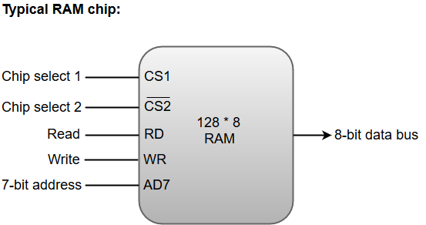

Slide 17
RAM
A 128 * 8 RAM chip has a memory capacity of 128 words of eight bits (one byte) per word. This requires a 7-bit address and an 8-bit bidirectional data bus.
The 8-bit bidirectional data bus allows the transfer of data either from memory to CPU during a read operation or from CPU to memory during a write operation.

Slide 18
RAM
The read and write inputs specify the memory operation, and the two chip select (CS) control inputs are for enabling the chip only when the microprocessor selects it.
The output generated by three-state buffers can be placed in one of the three possible states which include a signal equivalent to logic 1, a signal equal to logic 0, or a high-impedance state.

Slide 19
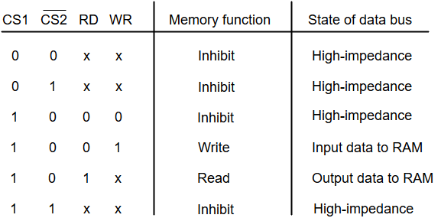
RAM
The following function table specifies the operations of a 128 * 8 RAM chip.

Slide 20
Types of RAM
The RAM integrated circuit chips are further classified into two possible operating modes, Static and Dynamic.
The primary compositions of a static RAM are flip-flops that store the binary information.
The nature of the stored information is volatile, i.e. it remains valid as long as power is applied to the system.
The static RAM is easy to use and takes less time performing read and write operations as compared to dynamic RAM.

Slide 21
Types of RAM
The dynamic RAM exhibits the binary information in the form of electric charges that are applied to capacitors.
The capacitors are integrated inside the chip by MOS transistors. The dynamic RAM consumes less power and provides large storage capacity in a single memory chip.

Slide 22
Static RAM:
Data is stored in transistors and requires a constant power flow. Because of the continuous power, SRAM doesn’t need to be refreshed to remember the data being stored.
SRAM is called static as no change or action i.e. refreshing is not needed to keep the data intact. It is used in cache memories.
Advantage: Low power consumption and faster access speeds. Disadvantage: Fewer memory capacities and high costs of manufacturing.

Slide 23
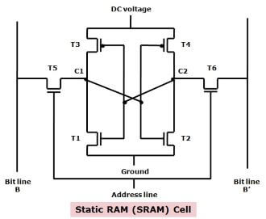
Static RAM:

Slide 24
Static RAM:
It has a special arrangement of transistors that makes a flip-flop, a type of memory cell.
One memory cell stores one bit of data. Most of the modern SRAM memory cells are made of six CMOS transistors, but lack capacitors.
The access time in SRAM chips can be as low as 10 nanoseconds.
The Static RAM is fast because the six-transistor configuration of its circuit maintains the flow of current in one direction or the other (0 or 1).

Slide 25
Static RAM:
The drawback with Static RAM is that its memory cells occupy more space on a chip than the DRAM memory cells for the same amount of storage space (memory) as it has more parts than a DRAM. So, it offers less memory per chip.

Slide 26
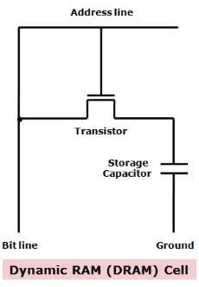
Dynamic RAM:
Dynamic Ram (DRAM) is also made up of memory cells. It is an integrated circuit (IC) made of millions of transistors and capacitors which are extremely small in size and each transistor is lined up with a capacitor to create a very compact memory cell so that millions of them can fit on a single memory chip.

Slide 27
Dynamic RAM:
So, a memory cell of a DRAM has one transistor and one capacitor and each cell represents or stores a single bit of data in its capacitor within an integrated circuit.
The capacitor holds this bit of information or data, either as 0 or as 1.
The transistor, which is also present in the cell, acts as a switch that allows the electric circuit on the memory chip to read the capacitor and change its state.

Slide 28
Dynamic RAM:
The capacitor needs to be refreshed after regular intervals to maintain the charge in the capacitor.
This is achieved by placing the memory on a refresh circuit that rewrites the data several hundred times per second. The access time in DRAM is around 60 nanoseconds.
This is called refreshing the memory and this process continues automatically thousands of times per second. So, this type of RAM needs to be dynamically refreshed all the time.

Slide 29
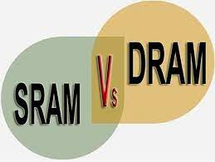
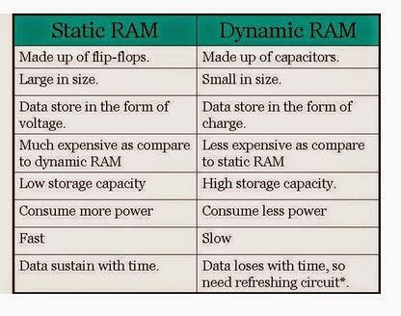

Slide 30
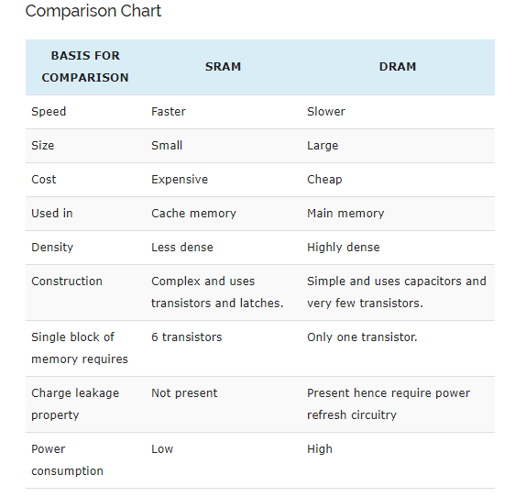

Slide 31
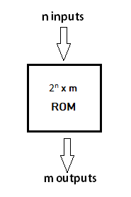
ROM :
ROM, which stands for Read Only Memory, is a memory device or storage medium that stores information permanently.
The block of ROM has 'n' input lines and 'm' output lines. Each bit combination of the input variables is known as an address.

Slide 32
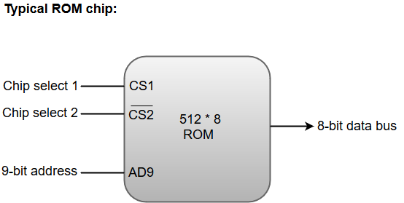

Slide 33
ROM :
Apart from the permanent storage of data, the ROM portion of main memory is needed for storing an initial program called a bootstrap loader.
The primary function of the bootstrap loader program is to start the computer software operating when power is turned on.
ROM chips are also available in a variety of sizes and are also used as per the system requirement. The following block diagram demonstrates the chip interconnection in a 512 * 8 ROM chip.

Slide 34
ROM :
A ROM chip has a similar organization as a RAM chip. However, a ROM can only perform read operation; the data bus can only operate in an output mode.
The 9-bit address lines in the ROM chip specify any one of the 512 bytes stored in it.
The value for chip select 1 and chip select 2 must be 1 and 0 for the unit to operate. Otherwise, the data bus is said to be in a high-impedance state.

Slide 35
Types of ROM:
Read only memories are non volatile in nature. The storage is permanent, but it is read only memory. We can not store new information in ROM.
Several types of ROM are available:
MROM : Masked Read Only Memory
PROM : Programmable Read Only Memory
EPROM : Erasable Programmable Read Only Memory
EEPROM : Electrically Erasable Programmable Read Only Memory
FLASH ROM

Slide 36
Types of ROM:
Masked Read Only Memory (MROM):
It is the oldest type of read only memory (ROM). In this, programs and instructions are stored at the time of Manufacturing.
So, it cannot be modified, reprogrammed, or erased later.
Inexpensive
The MROM chips are made of integrated circuits.

Slide 37
Types of ROM:
PROM: Programmable Read Only Memory:
PROM is a blank version of ROM. It is manufactured as blank memory and programmed after manufacturing.
It can be programmed only once as per user requirements.
It is not Erasable.
Uses:It is used in cell phones, video game consoles,etc.

Slide 38
Types of ROM:
EPROM: Erasable Programmable Read Only Memory:
It can be reprogrammed and erased many times.
It can be erased by exposing it to Ultra violet light for approx. 40 minutes.
An EPROM Eraser achieves this function.
Uses: It is used in some micro-controllers to store program.

Slide 39
Types of ROM:
EEPROM: Electrically Erasable Programmable Read Only Memory:
It is programmed and Erased Electrically.
It can be erased and reprogrammed about 10,000 times.
Both Erasing and programming takes about 4 to 10 ms.
Any location can be selectively erased, rather than erasing entire chip.
Uses: The BIOS of a computer is stored in this memory.

Slide 40
Types of ROM:
FLASH ROM:
It is an advanced version of EEPROM.
We can write blocks of data at a particular time. Where as, in EEPROM we can write only 1 byte of data at a time. So, this memory is faster than EPROM.
It is highly durable as it can bear high temperature and intense pressure.
Uses: It is used in USB flash drives, MP3 players, digital cameras, modems,etc.

Slide 41


